Slide 1
Java Menu
A. M. Bhave

Slide 2
Menu
A menu provides a space-saving way to let the user choose one of several options.
Other components with which the user can make a one-of-many choice include combo boxes, lists, radio buttons and tool bars.
A menu usually appears either in a menu bar or as a popup menu.
A menu bar contains one or more menus and has a customary, platform-dependent location — usually along the top of a window.
A popup menu is a menu that is invisible until the user makes a platform-specific mouse action, such as pressing the right mouse button, over a popup-enabled component.
The popup menu then appears under the cursor.

Slide 3
Menu
To create menus, the java.awt package comes with mainly four classes –
MenuBar,
Menu,
MenuItem and
CheckboxMenuItem.
All these four classes are not AWT components as they are not subclasses of java.awt.Component class.
They are subclasses of java.awt.MenuComponent

Slide 4
Menu
MenuBar: MenuBar holds the menus. MenuBar is added to frame with setMenuBar()method. Implicitly, the menu bar is added to the north (top) of the frame. MenuBar cannot be added to other sides like south and west etc.
Menu: Menu holds the menu items. Menu is added to frame with add() method. A sub-menu can be added to Menu.
MenuItem: MenuItem displays the actual option user can select. Menu items are added to menu with method addMenuItem(). A dull-colored line can be added in between menu items with addSeparator() method. The dull-colored line groups (or separates from other) menu items with similar functionality like cut, copy and paste.
CheckboxMenuItem: It differs from MenuItem in that it appears along with a checkbox. The selection can be done with checkbox selected.

Slide 5
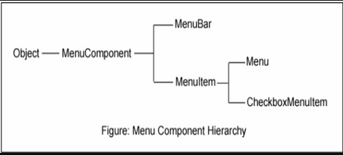
Menu
Java AWT Menu Hierarchy

Slide 6
Menu
import java.awt.*;
class MenuExample1
{
MenuExample1(){
Frame f= new Frame("Menu and MenuItem Example");
MenuBar mb=new MenuBar();
Menu menu=new Menu("Menu");
Menu submenu=new Menu("Sub Menu");
MenuItem i1=new MenuItem("Item 1"); MenuItem i2=new MenuItem("Item 2");
MenuItem i3=new MenuItem("Item 3"); MenuItem i4=new MenuItem("Item 4");
MenuItem i5=new MenuItem("Item 5");
menu.add(i1); menu.add(i2); menu.add(i3);
submenu.add(i4); submenu.add(i5);
menu.add(submenu); mb.add(menu);
f.setMenuBar(mb); f.setSize(400,400); f.setLayout(null); f.setVisible(true);
}
public static void main(String args[])
{new MenuExample1();}
}

Slide 7
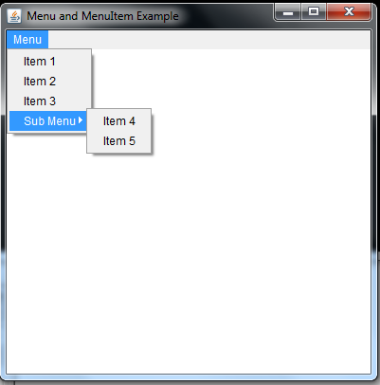
Menu

Slide 8
Menu
import java.awt.*;
import java.awt.event.*;
public class SimpleMenuExample extends Frame implements ActionListener
{
Menu states, cities;
Label l=new Label();
public SimpleMenuExample()
{
MenuBar mb = new MenuBar(); // begin with creating menu bar
setMenuBar(mb); // add menu bar to frame
l.setBounds(50,250,200,40);
add(l);
states = new Menu("Indian States"); // create menus
cities = new Menu("Indian Cities");

Slide 9
Menu
mb.add(states); // add menus to menu bar
mb.add(cities);
states.addActionListener(this); // link with ActionListener for event handling
cities.addActionListener(this);
states.add(new MenuItem("Himachal Pradesh"));
states.add(new MenuItem("Rajasthan"));
states.add(new MenuItem("West Bengal"));
states.addSeparator(); // separates from north Indian states from south Indian
states.add(new MenuItem("Andhra Pradesh"));
states.add(new MenuItem("Tamilnadu"));
states.add(new MenuItem("Karnataka"));
cities.add(new MenuItem("Delhi"));
cities.add(new MenuItem("Jaipur"));
cities.add(new MenuItem("Kolkata"));
cities.addSeparator(); // separates north Indian cities from south Indian

Slide 10
Menu
cities.add(new MenuItem("Hyderabad"));
cities.add(new MenuItem("Chennai"));
cities.add(new MenuItem("Bengaluru"));
setTitle("Simple Menu Program"); // frame creation methods
setSize(300, 300);
setLayout(null);
setVisible(true);
}
public void actionPerformed(ActionEvent e)
{
String str = e.getActionCommand(); // know the menu item selected by the user
l.setText("You selected " +str);
l.setForeground(Color.red);
}
public static void main(String args[])
{
new SimpleMenuExample();
}
}

Slide 11
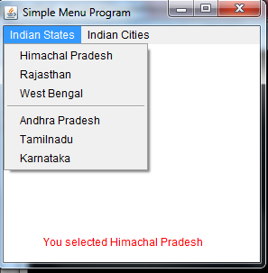
Menu

Slide 12
Java AWT Dialog
The Dialog control represents a top level window with a border and a title used to take some form of input from the user. It inherits the Window class.
Unlike Frame, it doesn't have maximize and minimize buttons.
Frame vs Dialog
Frame and Dialog both inherits Window class. Frame has maximize and minimize buttons but Dialog doesn't have.

Slide 13
Java AWT Dialog
Class constructors
Dialog(Dialog owner)
Constructs an initially invisible, modeless Dialog with the specified owner Dialog and an empty title.
Dialog(Dialog owner, String title)
Constructs an initially invisible, modeless Dialog with the specified owner Dialog and title.
Dialog(Dialog owner, String title, boolean modal)
Constructs an initially invisible Dialog with the specified owner Dialog, title, and modality.

Slide 14
Java AWT Dialog
import java.awt.*;
import java.awt.event.*;
public class DialogExample {
private static Dialog d;
DialogExample() {
Frame f= new Frame();
d = new Dialog(f , "Dialog Example", true);
d.setLayout( new FlowLayout() );
Button b = new Button ("OK");
b.addActionListener ( new ActionListener()
{
public void actionPerformed( ActionEvent e )
{
DialogExample.d.setVisible(false);
}
});
d.add( new Label ("Click button to continue."));
d.add(b);
d.setSize(300,300);
d.setVisible(true);
}
public static void main(String args[])
{
new DialogExample();
}
}

